Slide 1

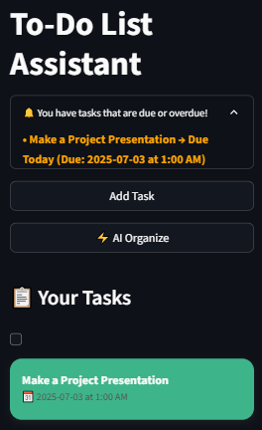
AI To-Do List Assistant
Smart task management for daily chores.

Slide 2

Executive Summary
The AI To-Do List Assistant is an intelligent task management system designed to organize and track daily chores. It uses NLP to understand commands like "Add task: Submit assignment by Friday" and manages them effectively.
Core Functionalities
PEAS Framework
Key Outcomes
Add, delete, list, summarize tasks, and provide reminders.
Performance, Environment, Actuators, Sensors define its intelligent operation.
Improved productivity, timely reminders, customizable task flow.

Slide 3
Project Overview & Objectives
Dual Interface System
Priority & Notifications
Offers both a Streamlit UI and a Command Line Interface (CLI) for task management.
Supports priority-based organization and deadline notifications.
Reliable Task Storage
NLP for CLI
Ensures persistent task storage using JSON files.
CLI uses NLP for natural language input processing and dynamic task creation.

Slide 4





AI Agent Architecture
Form Input Processing
Streamlit widgets with validation.
Task Storage Management
JSON persistence for tasks.
Scheduled Reminder Checks
Monitors deadlines.
CLI NLP Layer
Processes natural language commands.

Slide 5




PEAS Framework
Performance
Accuracy of task operations, reminder timing, NLP success rate.
Environment
Streamlit web UI and CLI for NLP-based interaction.
Actuators
Task list modifications, visual reminders, console outputs.
Sensors
Web form inputs, system clock, text commands with entities.

Slide 6
Algorithms & Techniques
Streamlit Reactive Components
For UI management.
spaCy Entity Recognition
For CLI command parsing.
Priority-Based Sorting
Very important/medium/low.
JSON Serialization
For platform-independent storage.
Datetime Comparisons
For reminder triggers.

Slide 7
Development Challenges & Solutions
Flexible User Input
Challenge: Empty task descriptions. Solution: Input validation and clear error messages.
Calendar Due Date Selection
Challenge: Manual date entry errors. Solution: `st.date_input` widget for calendar selection.
Persistent UI State
Challenge: Streamlit reruns losing state. Solution: `st.session_state` to retain inputs and data.

Slide 8
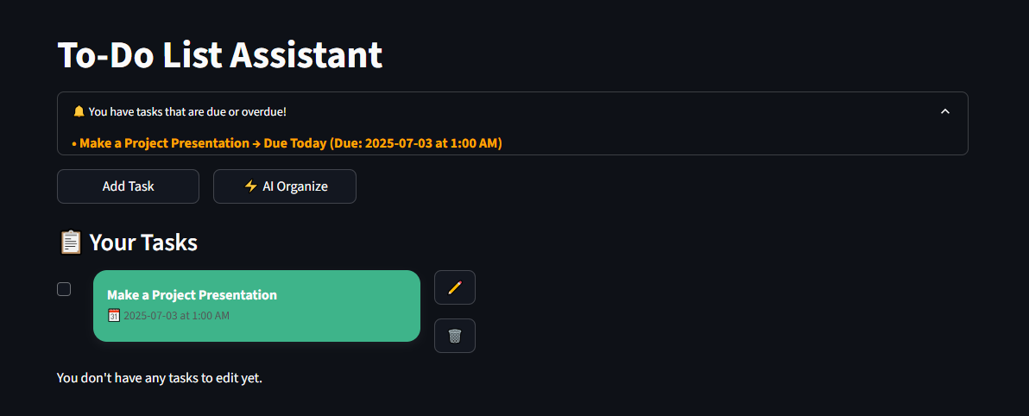
Performance Metrics
Task Operations Efficiency
Web Interface (Streamlit)
CRUD Latency: < 100ms for local JSON updates.
Render Time: < 1s initial load, 200-500ms rerun latency.
Storage Scalability: > 1,000 tasks before UI lag.
Concurrency: Default thread-safe for single-user sessions.
Reminder System
Check Overhead: 0.5ms per 100 tasks.
Frequency: Runs on every Streamlit rerun.

Slide 9
Limitations & Future Work
No Multi-User Support
Implement user authentication and session management.
JSON Not Scalable
Replace with SQLite or MongoDB for larger task numbers.
No Recurring Tasks
Add functionality for daily, weekly, or custom intervals.
In-App Only Reminders
Expand to OS-level, email, or mobile push notifications.

Slide 10
THANK YOU!
ANY QUESTIONS?
Group Members: Arsema Yemiru
Meklit Tewodros
Tnsae Alemayehu
Yeabtsega Argaw

